Slide 1
Intro to Neural Nets
Course Logistics and Introduction

Slide 2

Today’s Agenda
1. COURSE LOGISTICS
Website, schedule, grading and evaluation criteria.
Course textbook, lecture format, etc.
2. INTERESTING USE CASES
Frivolous, academic, and practically useful.
A recent failure, and societal concerns.
3. QUICK INTRODUCTION
What is a neural network?
How does it work?

Slide 3




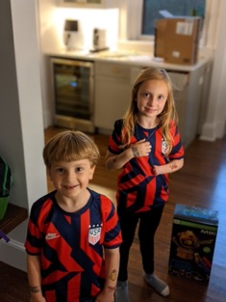






About Me

Slide 4
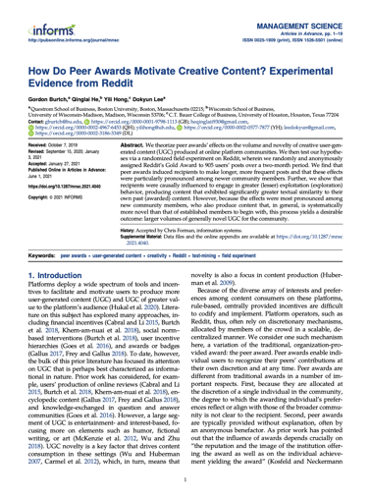
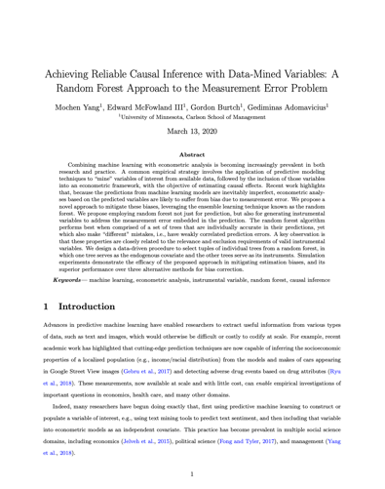
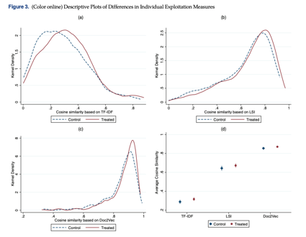
My Research

Slide 5
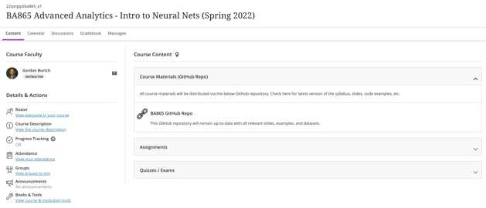


Course Materials
COURSE WEBSITE
The course website is on Blackboard – I assume you have looked at it by this point (if you aren’t enrolled in the site, let me know)
You will submit all assignments and receive relevant course announcements via this site.
I will post lecture materials and in-class exercises / examples in the GitHub Repository that is linked on Blackboard.
GOOGLE COLAB
All homework and exercises in this course will be implemented in Python. You are welcome to employ a local instance of Python, but for simplicity’s sake I would recommend you work in Google Colab, because we (the TA and I) will not be able to provide technical support. We will rely heavily on Jupyter Notebooks.

Slide 6
Grading and Evaluation
25%
HOMEWORK
Two (2) assignments worth 25% of your final grade, each, to be completed in groups of no more than 2 students (indicate group members as part of your submission); you can also complete these assignments by yourself, if you prefer.
Each homework problem set is based on preceding lab / course material. Due before the start of class on the indicated submission date – submit via Blackboard only!
Per the syllabus, late submissions will not be accepted.
25%
50%
FINAL PROJECT
The final project will be presented during the last regularly scheduled classroom session.
You will work in groups of 2-3 (your choice) to implement a neural network-based predictive model that addresses a practical problem of interest to you! You will source your own dataset, motivate the prediction problem (explain why it’s practically relevant), and then implement the predictive model. Your goal should be to make this project useful for you!
The deliverables will include a project proposal due in Week 2 (5%), a mid-point check-in meeting with me to ensure you are on track (5%)

Slide 7

Course Textbook
Chollet, François. (2021). Deep Learning with Python (2nd Edition). Manning Publications Co. ISBN-13: 978-1617296864. https://www.manning.com/books/deep-learning-with-python- second-edition

Slide 8

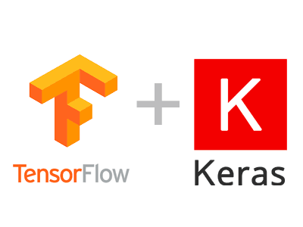


Required Software
SOFTWARE CONFIGURATION
You can access Google Colab at https://colab.research.google.com. You probably want to use your BU Google account credentials.
If you wish, you may run Python / Jupyter notebooks locally, installing the relevant packages, but please note that we (the TA and I) cannot provide any technical support.

Slide 9
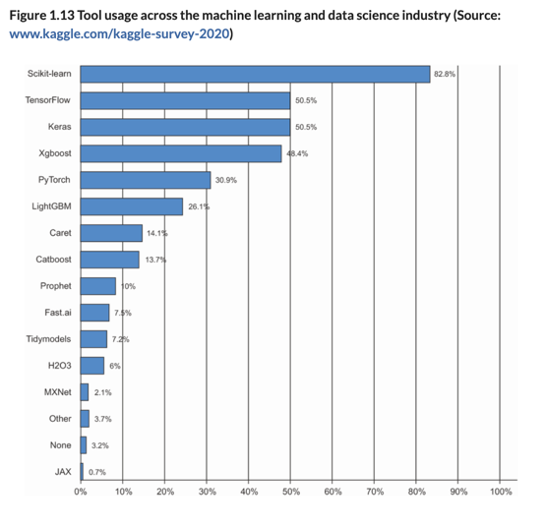
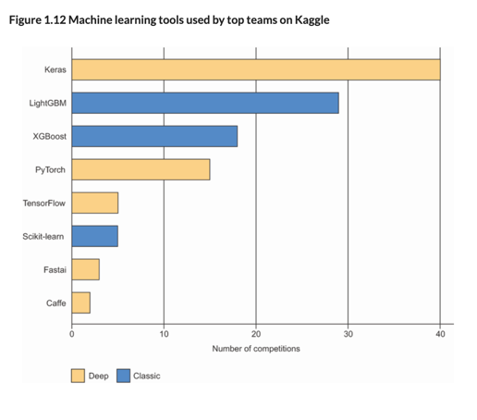
Why Keras?

Slide 10
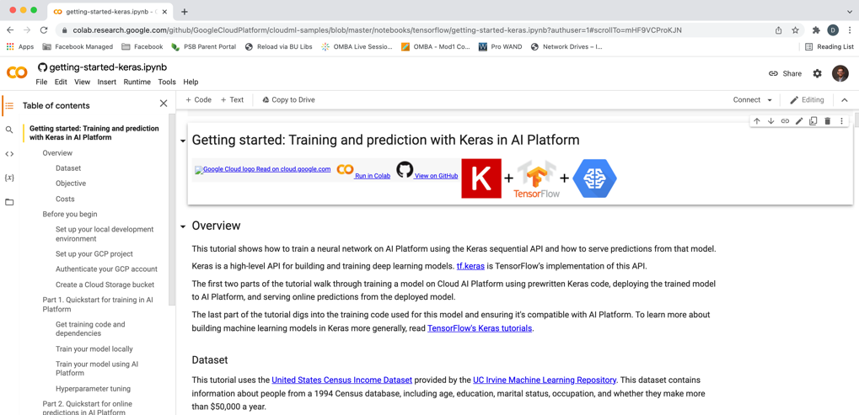
Google Colab

Slide 11
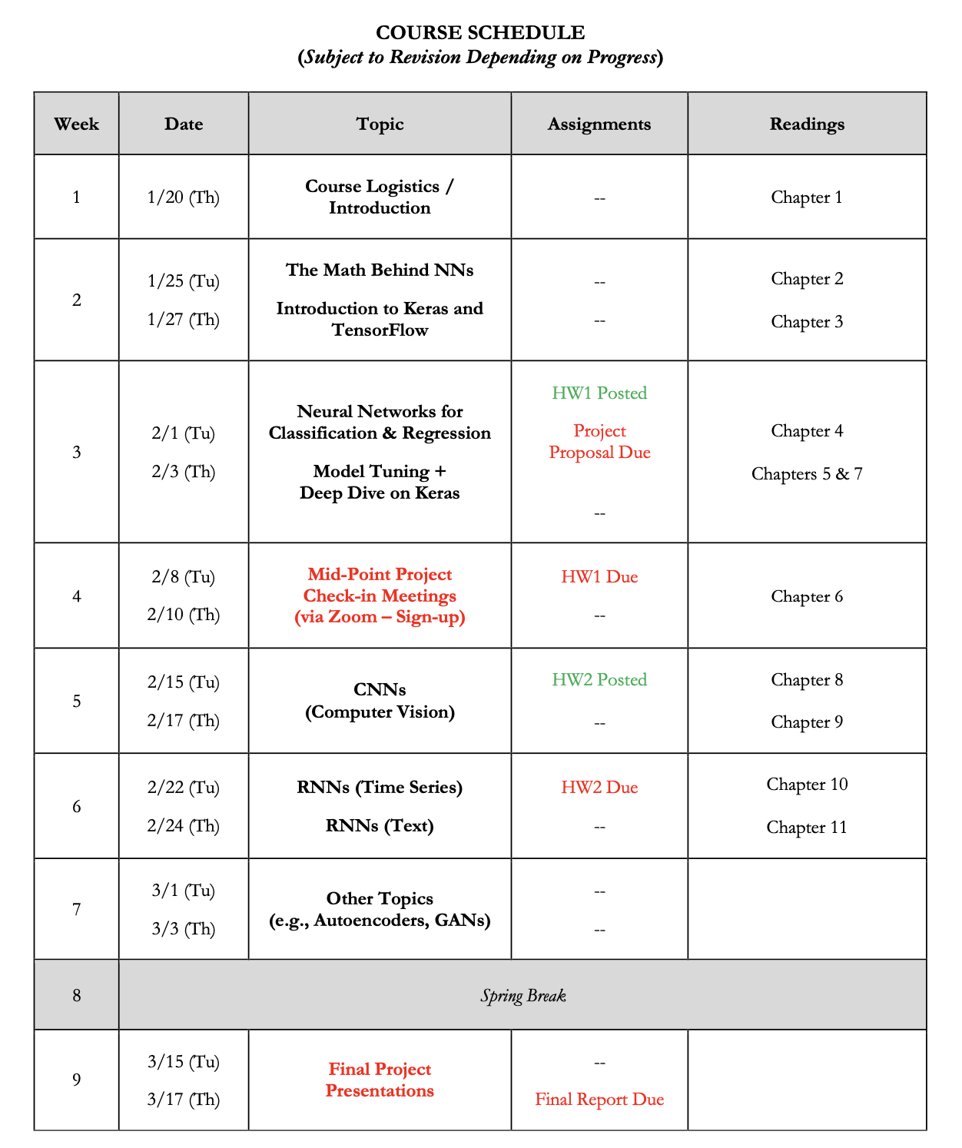
Course Timeline
AGENDA
We will start with the concepts.
We will then get into basic neural networks for simple prediction problems.
Finally, we will get into more complex use cases, namely computer vision, NLP, and time series.
NOTE TIMING OF DELIVERABLES
First homework on basic prediction.
Second homework on image-based prediction.
There will be sign-ups for the week of 2/8 – 2/10, for your mid-point project check-in meeting.
ONE FLEX WEEK
This course is significantly revamped, so I reserve the right to revise our schedule depending on how we progress. Week 7 is tentatively going to cover autoencoders and perhaps another topic, but we may be playing catch-up at that point!

Slide 12

Course
LECTURES
We will meet twice weekly (beginning from Week 2), for ~2.5 hours each session. I will incorporate a 20-minute break in the middle of each session.
The first half of each session will focus on lecture / concepts / explanation.
HANDS-ON EXERCISES
The second half of each session will be focused on implementing hands-on examples / demonstration in Python.
I will provide you with Jupyter Notebooks and data-sets via GitHub, which we will walk through together.
You are encouraged to ask questions as we progress.
Note that the two homework assignments will be based on the in-class lab exercises / questions.

Slide 13
Any Questions?

Slide 14
What is ‘Deep’ (vs. Shallow) Learning?

Slide 15
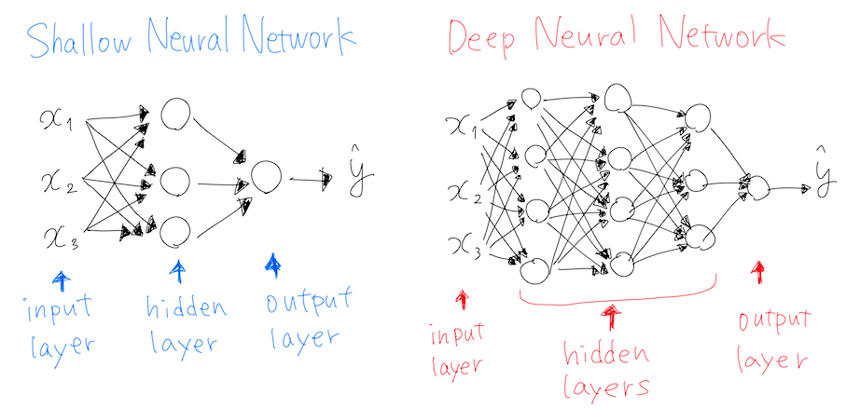
What is ‘Deep’ Learning?
Notes:
Most other ML approaches are shallow (they map inputs to outputs in a single layer / transformation, or few layers). Deep here refers to the fact that there is a layered approach to transformation. 4 or more layers, generally, by which transformations feed into other transformations, enabling flexible representation of mappings.

Slide 16
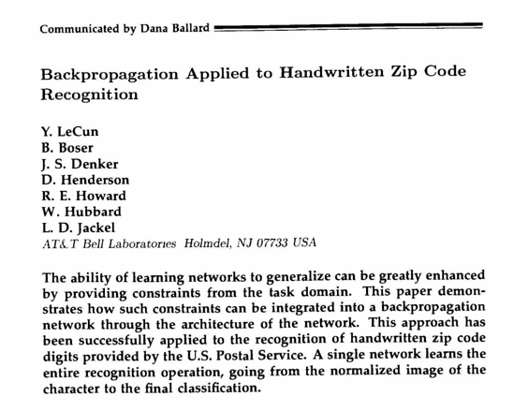
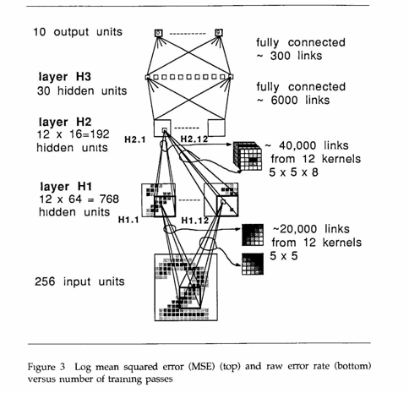
Where Deep Learning Started

Slide 17
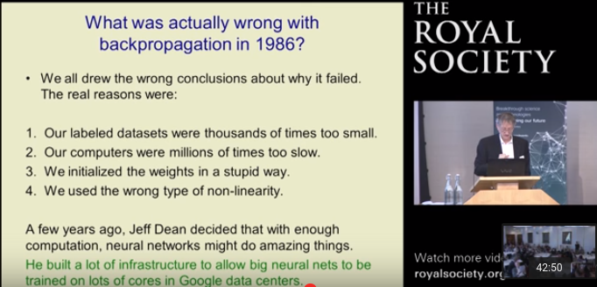
Then It Shuffled Along for Decades…
Now…
Notes:
Vanishing gradient problem,

Slide 18


Slide 19
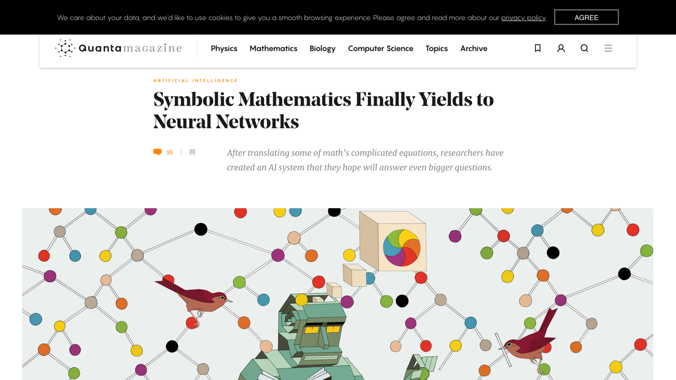

Slide 20
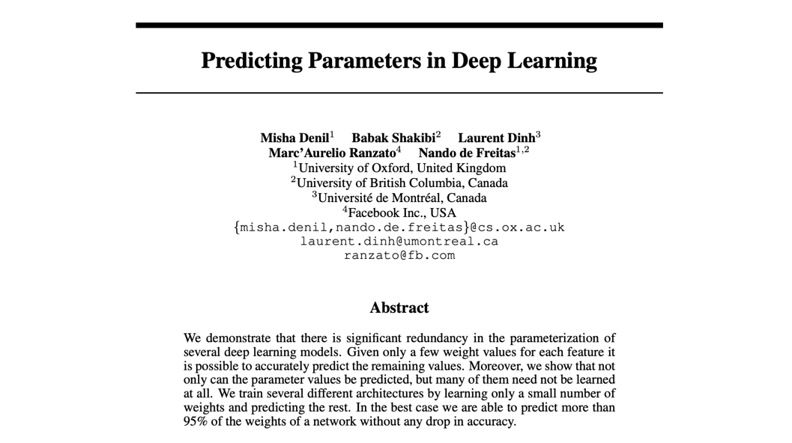

Slide 21
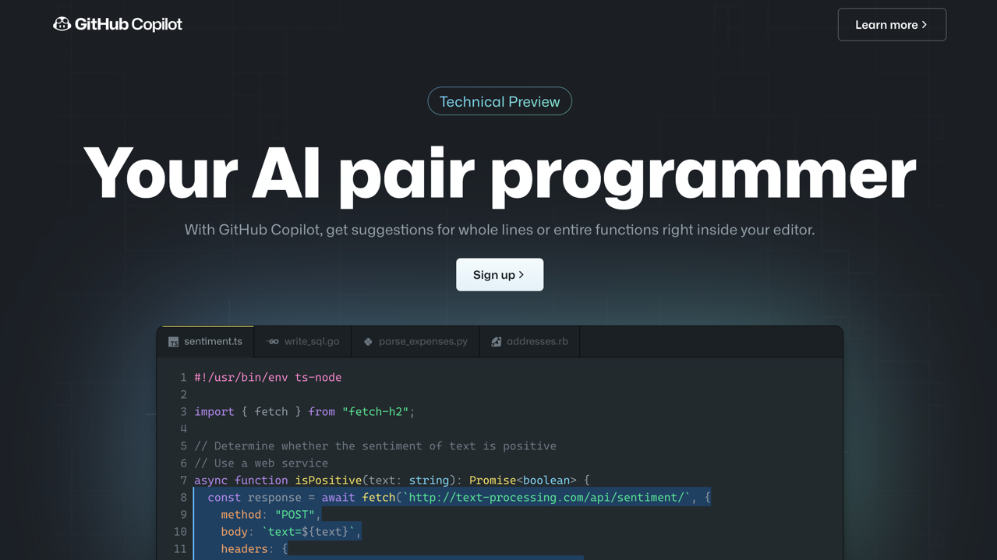

Slide 22
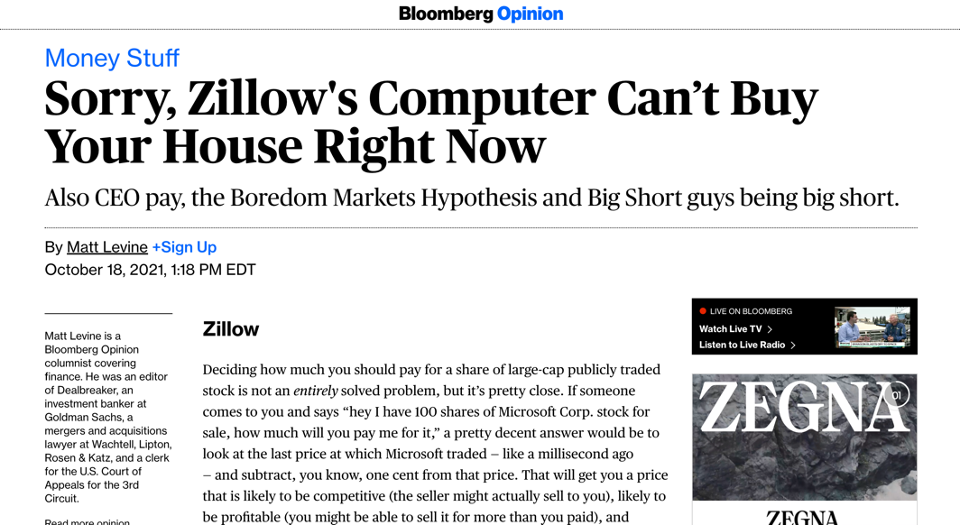

Slide 23


Slide 24
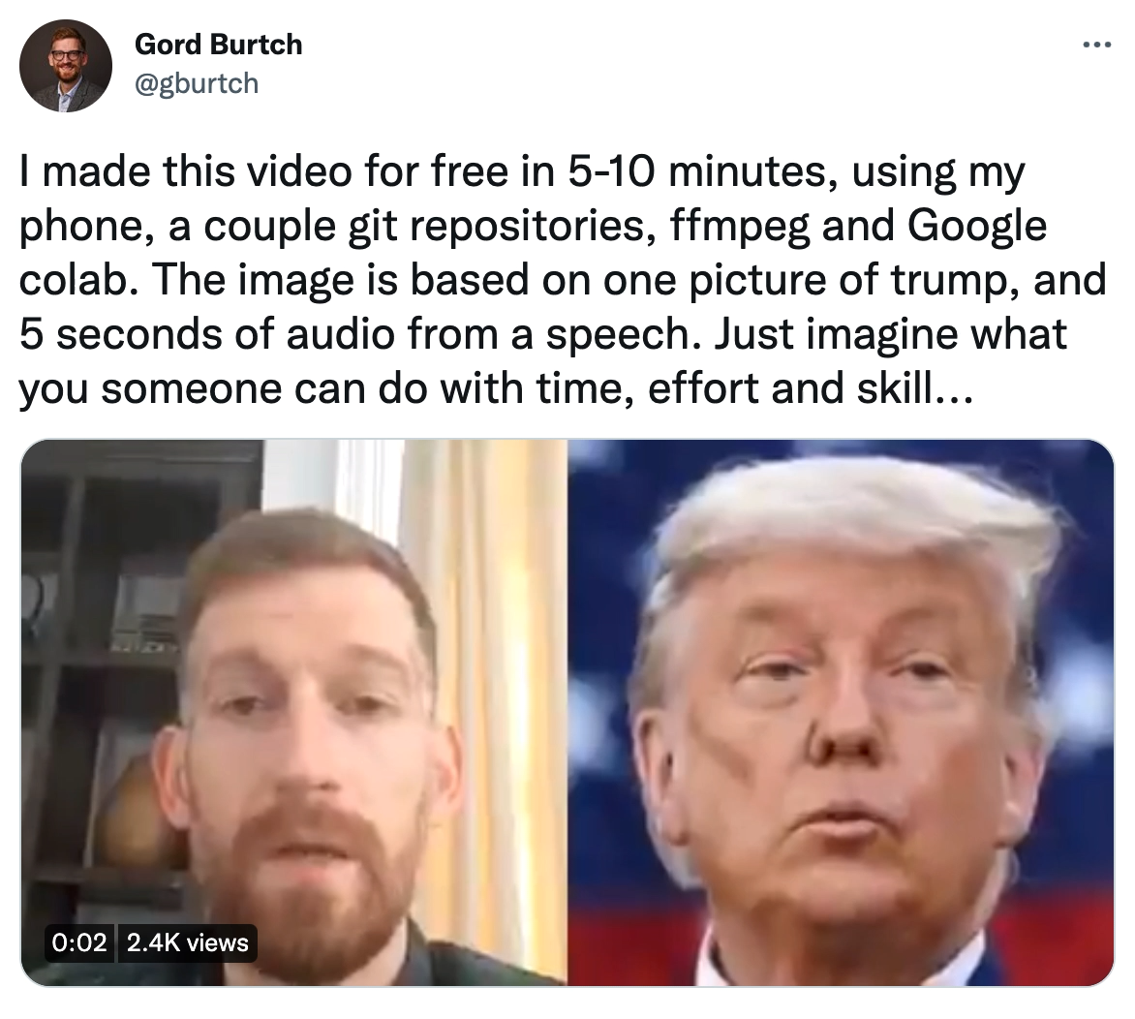

Slide 25
How It Works, Conceptually

Slide 26
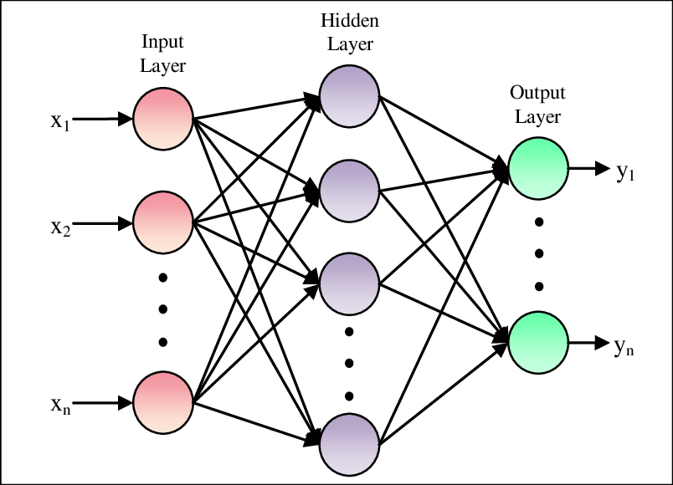
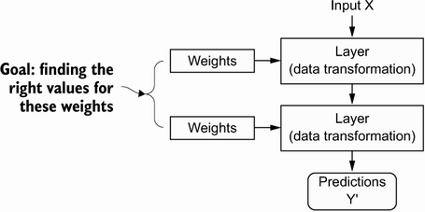
Model Parameters

Slide 27
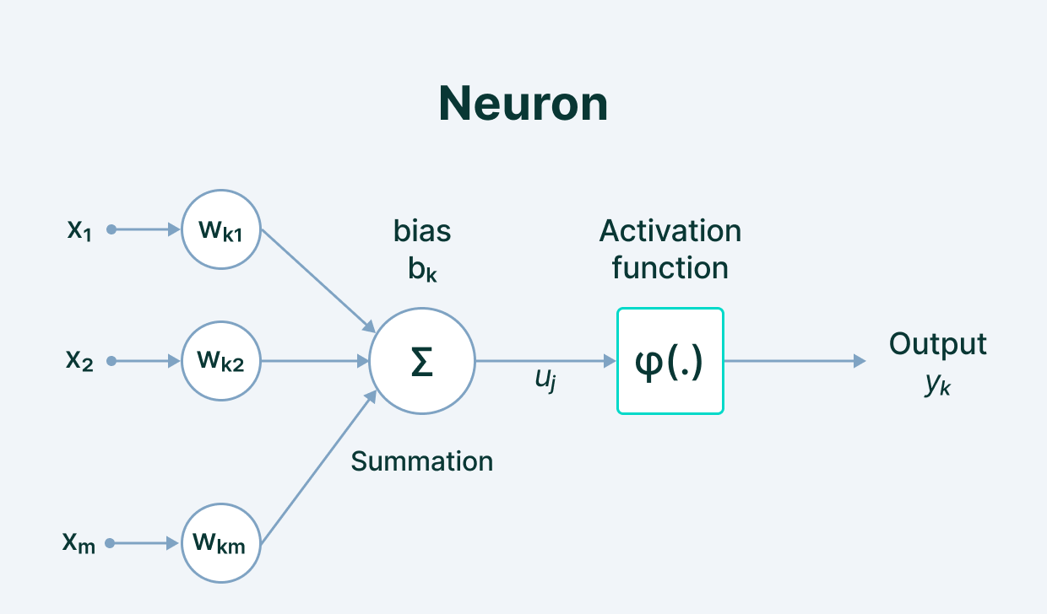
Model Parameters
Notes:
We define the network structure (layers / nodes / edges) and the activate functions (within each node). Our data, X and Y (inputs and labels) are given. Our goal is then to “learn” the remaining parameters, i.e., the w’s and b’s.

Slide 28
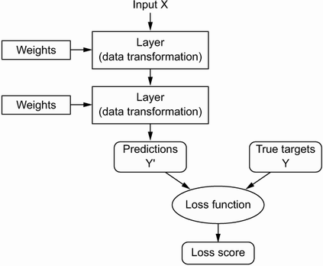
Loss Function (Error)
Notes:
How do we learn the parameters? We need a way to quantify how well we are doing. This is what the loss function is for; it informs our optimization about how ”optimal” our current set of parameter values is.

Slide 29
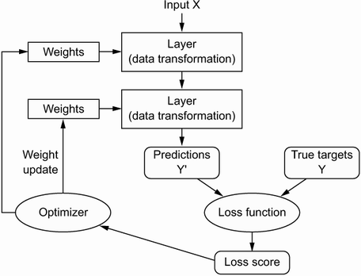
Optimization
Notes:
How do we implement the learning (optimization)? Gradient descent. We identify where we are on the loss curve, figure out a first derivative along all available dimensions (i.e., along all parameters), and proceed where the gradient is most negative (i.e., where the loss function progresses most rapidly toward zero. For this to work, we need to be able to figure out the gradient along each dimension (for each parameter) in a computationally efficient way (remember, some of the biggest models have thousands or millions of parameters!).

Slide 30
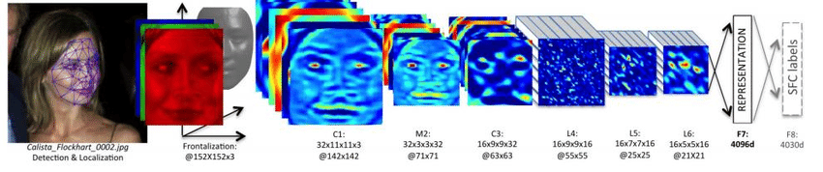
When to Learn Deeply (vs. Not)
COMPLEX RELATIONSHIPS
Complex, non-linear, interactive relationships and mappings; common use cases involve unstructured (high dimensional) data. Deep learning techniques remove the need for feature engineering, a daunting task.

Slide 31
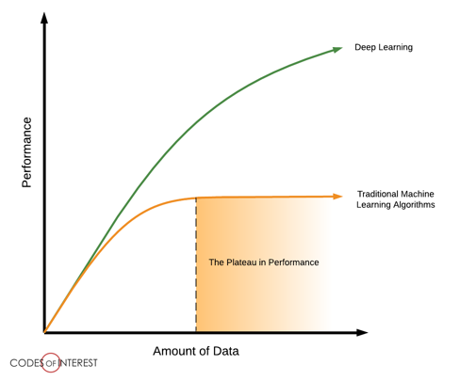
When to Learn Deeply (vs. Not)
LOTS OF DATA ON HAND
To be able to learn those complex mappings, typically requires many, many, many training examples.

Slide 32
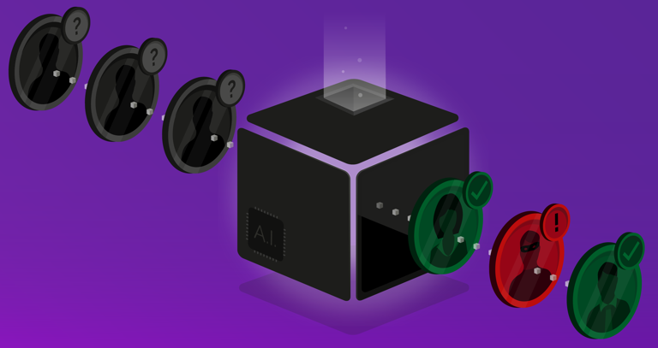
When to Learn Deeply (vs. Not)
LITTLE NEED FOR UNDERSTANDING
Although there have been advancements in explainable and interpretable AI, deep nets are notoriously “black box” algorithms.

Slide 33
Why Did Deep Learning Take Off?

Slide 34

Video Games
Notes:
GPUs were developed to handle parallel processing capabilities needed for high end video game graphics. Turns out those same designs were useful for training a neural net (parallel computation, through vectorization of code). Basically, training a deep net involves performing a shitload of matrix multiplications. It’s better if we can do those calculations in parallel rather than sequentially. GPUs (and now TPUs) enable a ton of parallelization, speeding up the calculations.

Slide 35
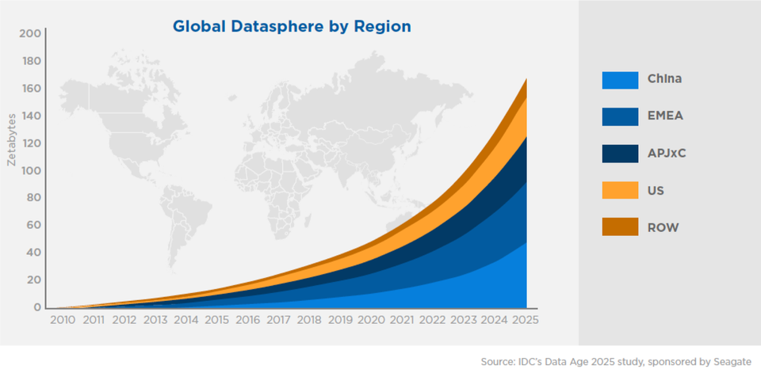
Data

Slide 36
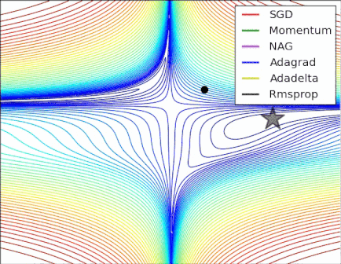
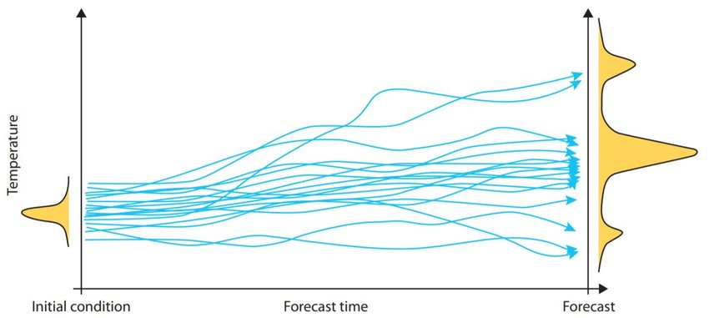
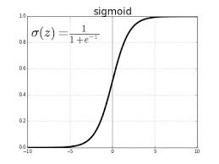
Algorithmic Improvements

Slide 37
Questions?

Slide 38

Walk-Through of Google Colab

